Slide 1
Evaluation in the Maldives
Aishath Saadh (Ms) Deputy Director General Sustainable Development Goals (SDGs) Division

Slide 2
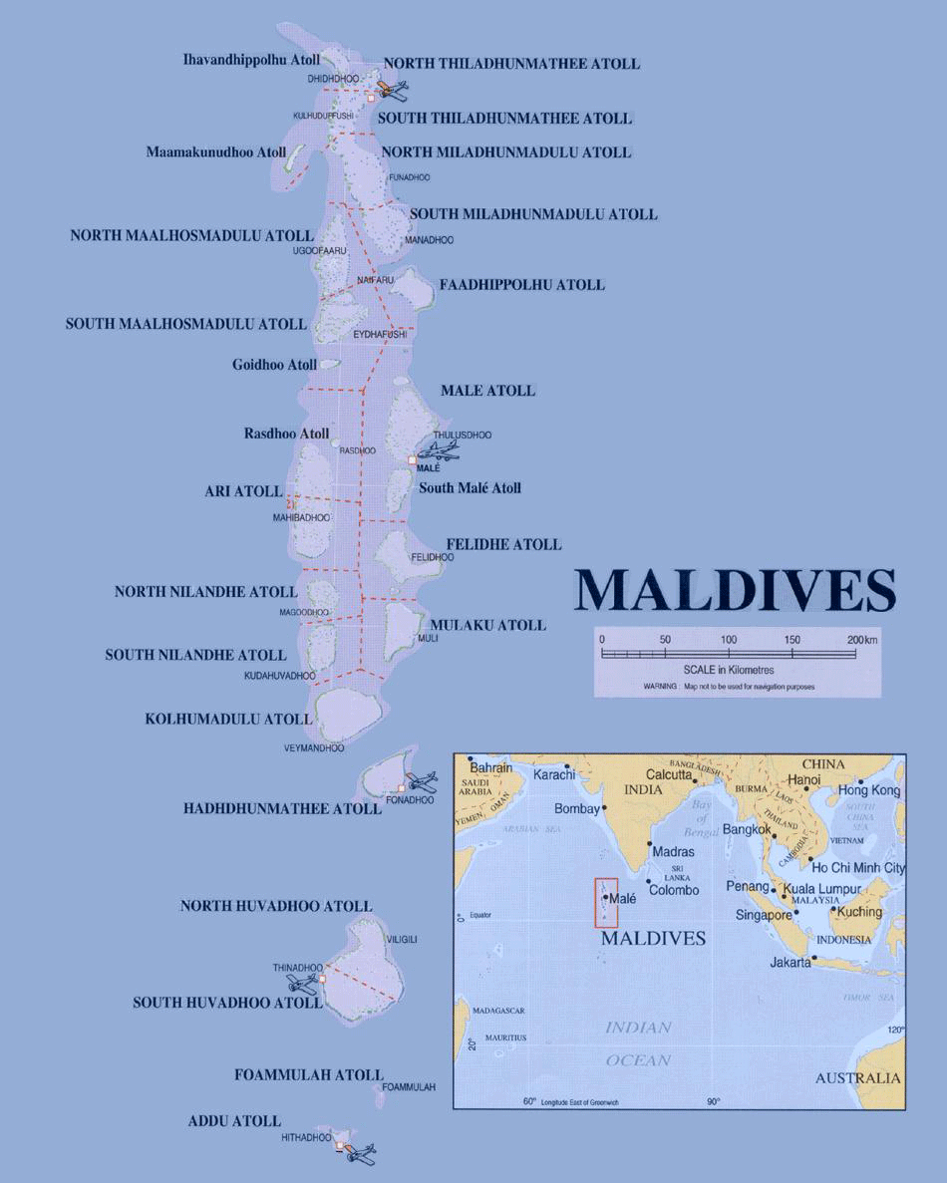
The Maldives
Over 1,192 island : 188 inhabited
Population of 402,071: high expect population
Male’ is the capital, with 1/3 of the population
High literacy rate, free education, high enrollment
life expectancy 72yrs, low infant mortality rate, high vaccine penetration
GDP per capita is at USD 4,521 (constant)
Major industry is tourism
25% direct contribution to DGP: 60% indirect
More than1,200,000 foreign tourists since 2014
Fisheries being the major export : 43 percent was fresh or chilled tuna.
Unemployment rate 11.7%: woman less in economic activities and high voluntary unemployment
Gini coefficient improved from 0.41 in 2003 to 0.37 in 2010

Slide 3
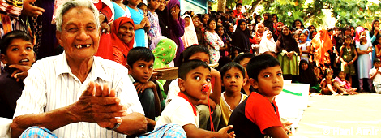
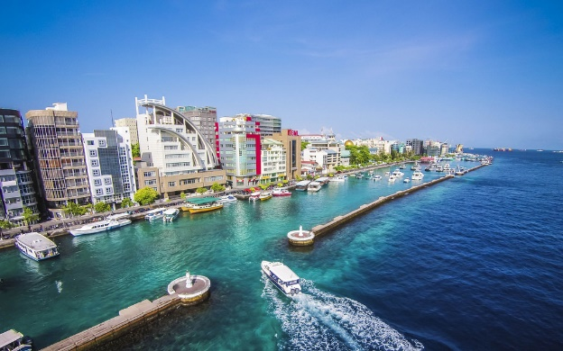
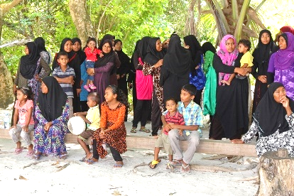
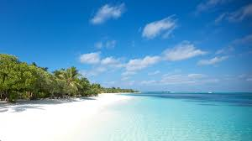
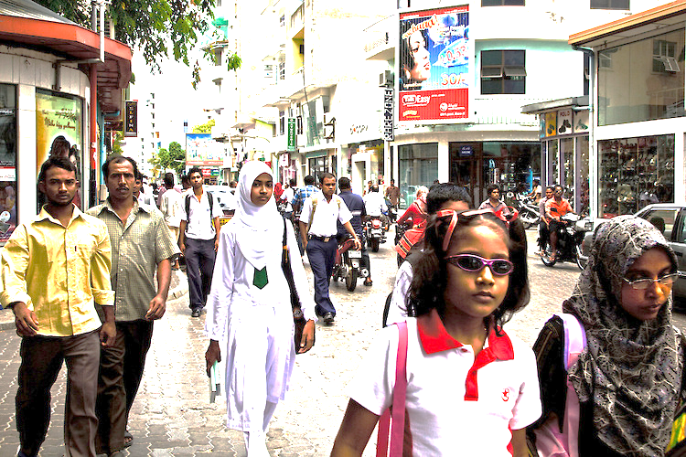
Our Development challenges
Sparsely dispersed population
High cost of provision and maintaining basic services: low utilization
Economies of scale
Vulnerable economy : high imports, foreign currency dependency, small economic base, prone to external shocks
Urban poverty of the rise
Economically active population low : specially woman
‘courting’ with the new democracy
Vulnerable environment : impact of climate change, costly adaptation measures

Slide 4
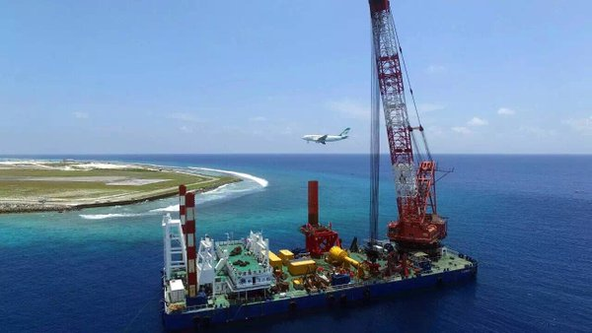
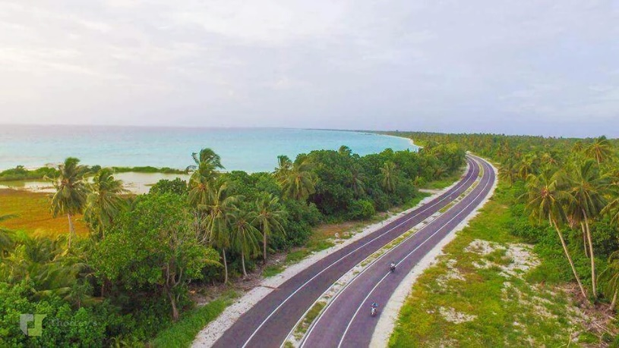
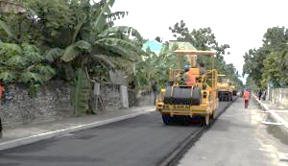
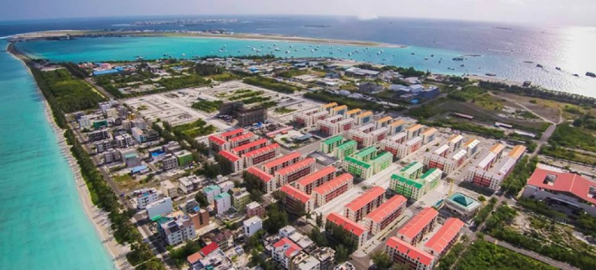
National Evaluation Policies and Systems
Lack of long-term plan to anchor ‘direction’
Ad hoc basis
More monitoring than evaluation
Lack of informed decision making
Working in silos, poor inter agency coordination
Duplication and repetition
Lack of feedback mechanism
More focus of fiscal impact : social and economic over looked

Slide 5
National Evaluation Policies and Systems
Economic and Youth Council (EYC)
Lack of technical evaluation of projects
Cabinet
Occasional decision making
Programs with development partners
Better technical evaluation
Mega development projects
Lack of inter-sectorial comments
Budget Formulation
Majority of the work done here
Consultation with sectors
Focus on fiscal monitoring and evaluation
Lack of feedback mechanism
<50 million MRV
Limited technical evaluation of projects
Regular monitoring and evaluation carried out
More widely consulted with stakeholders
More focus on fiscal impact
Focused on manifesto deliverables
Poor technical evaluation

Slide 6
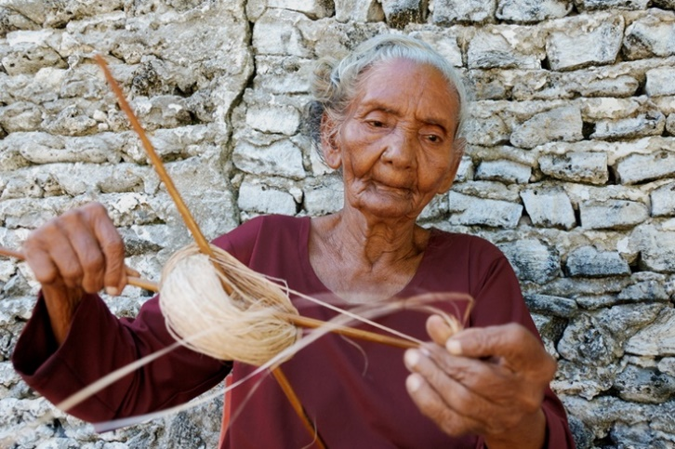
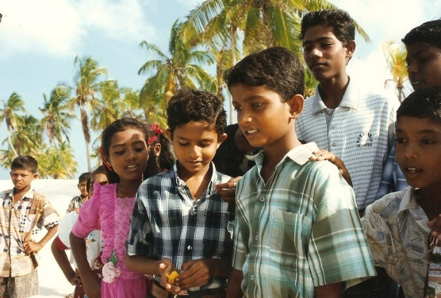
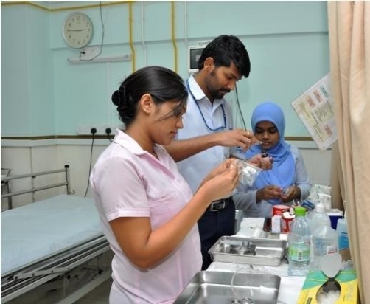
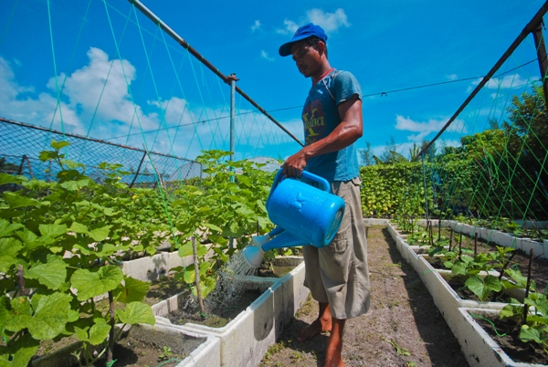
Current demand and use of evaluation
Lacks the knowledge about benefits of evaluation
Monitoring vs evaluation
Lack of political will to keep things more ‘fluid’
Increasing demand for move beyond ‘business as usual’
Enterprise resource planning (ERP) system is used for budget control and fund management – under utilized
Harmonize multiple reporting

Slide 7
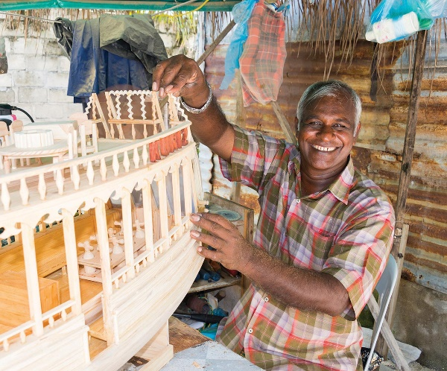
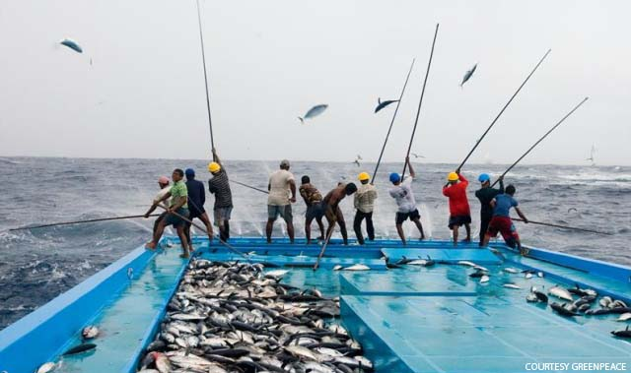
Challenges in promoting EFGR evaluation
Convincing the politician's
Moving to strategic planning vs fire-fighting
Creating awareness among key players/stakeholders
Better integration of programs and projects
Lack of understanding of evaluation and benefits

Slide 8
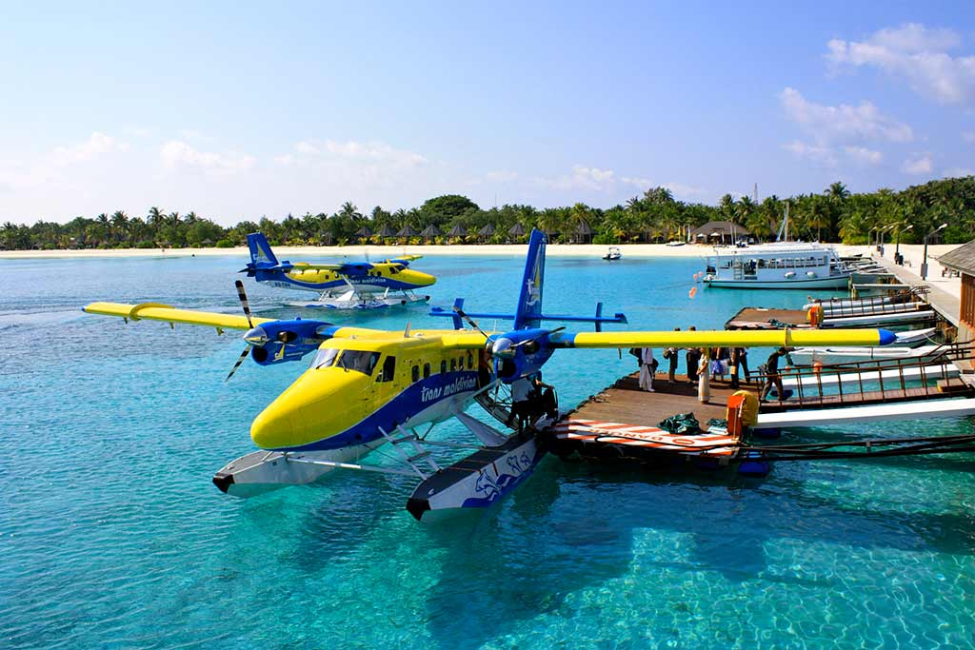
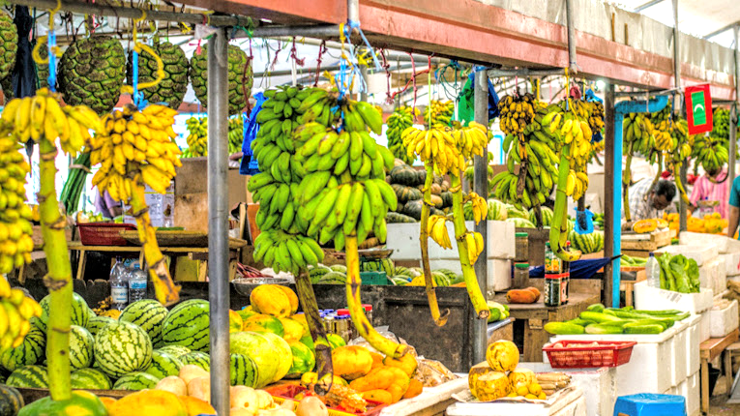
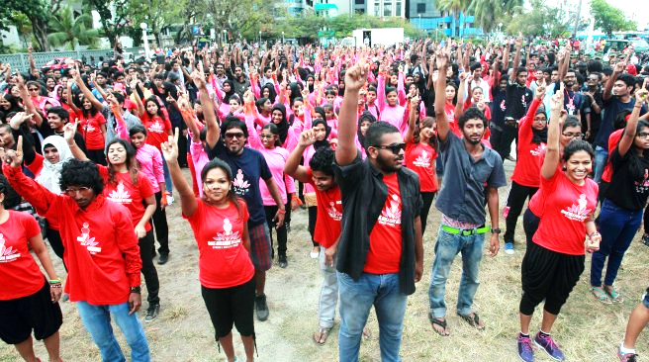
Strategies & FOLLOW-UP ACTIONS
Increased capacity-building at policy, managerial & technical levels
Urgent need for integrated system support e.g. Integrated RBM
Showcase good examples from other developing countries
Increase exposure to international experiences and benefits
Evaluation should be grounded within an integrated system
Peer group support from the Asia-Pacific region e.g. APEA
Improved exposure opportunities for key evaluation drivers

Slide 9
Thank You
Any questions?

